Slide 1
DR. R.A. LAWAL
Dept of Biochemistry,
CMUL, Idi-Araba.
BCH 202
INTRODUCTORY BIOCHEMISTRY II

Slide 2
Outline
Overview of BCH 202
2. Introduction to metabolism and bioenergetics
: Dietary requirements
: Digestion and Absorption of Carbohydrate
: Digestion and absorption of proteins
: Digestion and absorption of lipids

Slide 3
Overview of BCH 202 outline
Introduction to metabolism and bioenergetics.
Dietary requirement, digestion and absorption.
Catabolism of glucose; glycolysis, fermentation.
Cellular respiration; TCA cycle
Electron transport chain; Oxidative phosphorylation.
Catabolism of amino acids; their reactions
Cell fuel generation by amino acids.
Catabolism of fatty acids.
Cofactors and their biochemical functions.
Vitamins and their biochemical functions.
Physiological functions of hormones
Revision
In-course assessment

Slide 4
Bioenergetics-biochemical thermodynamics
FREE ENERGY IS THE USEFUL ENERGY IN A SYSTEM
Gibbs change in free energy (ΔG) is that portion of the total energy change in a system that is available for doing work—ie, the useful energy, also known as the chemical potential.
Enthalpy, H, is the heat content of the reacting system.
Entropy is the extent of disorder or randomness of the system and becomes maximum as equilibrium is approached.

Slide 5
Biologic Systems Conform to the General Laws of Thermodynamics.
The first law of thermodynamics states that the total energy of a system, including its surroundings, remains constant.
The second law of thermodynamics states that the
total entropy of a system must increase if a process is to occur spontaneously.

Slide 6
Under conditions of constant temperature and pressure, the relationship between the free energy change (ΔG) of a reacting system and the change in entropy (ΔS) is expressed by the following equation, which combines the two laws of thermodynamics:
If ΔG is negative, the reaction proceeds spontaneously with loss of free energy; ie, it is exergonic.
If, in addition, ΔG is of great magnitude, the reaction goes virtually to completion and is essentially irreversible.
On the other hand, if ΔG is positive, the reaction proceeds only if free energy can be gained; ie, it is endergonic.

Slide 7
If, in addition, the magnitude of ΔG is great, the system is stable, with little or no tendency for a reaction to occur.
If ΔG is zero, the system is at equilibrium and no net change takes place.

Slide 8


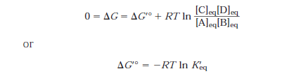
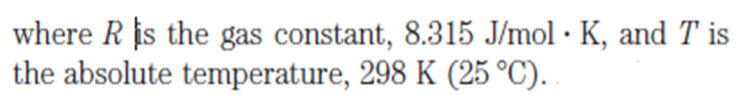
When the reactants are present in concentrations of
1.0 mol/L, ΔG⁰ is the standard free energy change. For biochemical reactions, a standard state is defined as having a pH of 7.0. The standard free energy change at this standard state is denoted by ΔG⁰′.

Slide 9
Cells are isothermal systems—they function at essentially constant temperature (they also function at constant pressure).
Heat flow is not a source of energy for cells, because heat can do work only as it passes to a zone or object at a lower temperature.
The energy that cells can and must use is free energy, described by the Gibbs free-energy function G, which allows prediction of the direction of chemical reactions, their exact equilibrium position, and the amount of work they can in theory perform at constant temperature and pressure.

Slide 10
In practice, an endergonic process cannot exist independently but must be a component of a coupled exergonic- endergonic system where the overall net change is exergonic.
The exergonic reactions are termed catabolism (generally, the breakdown or oxidation of fuel molecules), whereas the synthetic reactions that build up substances are termed anabolism. The combined catabolic and anabolic processes constitute metabolism.

Slide 11
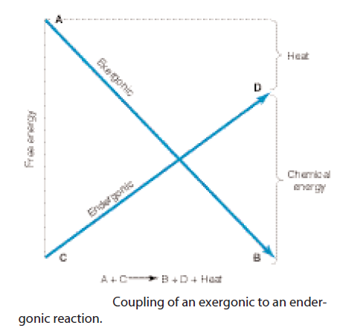

Slide 12
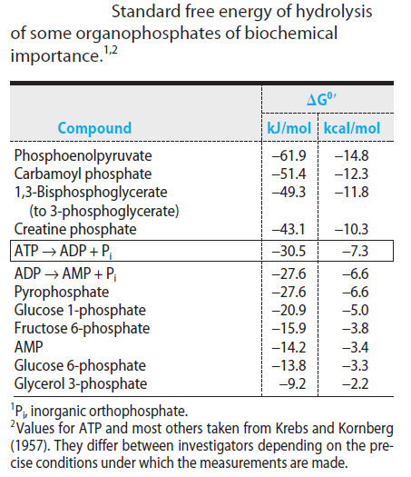
HIGH-ENERGY PHOSPHATES PLAY A
CENTRAL ROLE IN ENERGY CAPTURE
AND TRANSFER

Slide 13
Metabolism
Metabolism is the sum total of chemical transformations taking place in a cell or organism which occurs through a series of enzyme-catalyzed reactions.
These series of enzyme-catalyzed reaction constitutes METABOLIC PATHWAYS.

Slide 14
Each of the consecutive steps in a metabolic pathway brings about a specific, small chemical change.
This change is usually the removal, transfer or addition of a particular atom or functional group.
The precursor is converted into a product through a series of metabolic intermediates called METABOLITES.

Slide 15
TWO PHASES OF METABOLISM
CATABOLISM
Is the degradative phase of metabolism in which organic nutrient molecules (carbohydrates, fats and proteins) are converted into smaller, simpler end products (e.g lactic acid, CO₂ , NH₃ ).
- Catabolic pathways release energy, some of which is conserved in the formation of ATP and reduced electron carriers (NADH, NADPH & FADH₂).

Slide 16
ANABOLISM
Is the biosynthetic phase in which small, simple precursors are built up into larger and more complex molecules, including lipids, polysaccharides, proteins and nucleic acids.
Anabolic reactions require an input of energy, generally in the form of ATP or NADH/NADPH and FADH₂

Slide 17
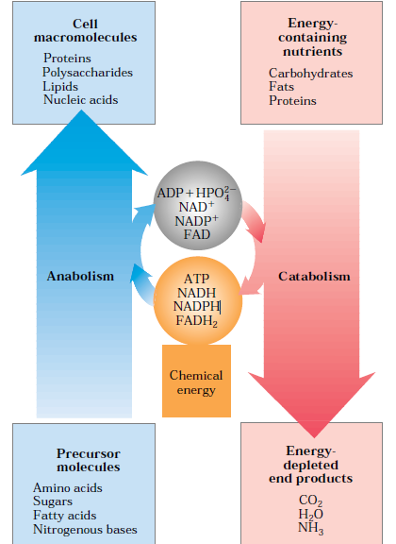
ANABOLISM AND CATABOLISM

Slide 18
STRATEGY OF METABOLISM
TO PRODUCE ATP.
2. TO GENERATE NADPH (REDUCING EQUIVALENTS).
3. SYNTHESIZE AND DEGRADE BIOMOLECULES REQUIRED IN SPECIALIZED CELLULAR FUNCTIONS.
4. TO ALTERNATE DEGRADATIVE AND BIOSYNTHETIC PATHWAY.

Slide 19
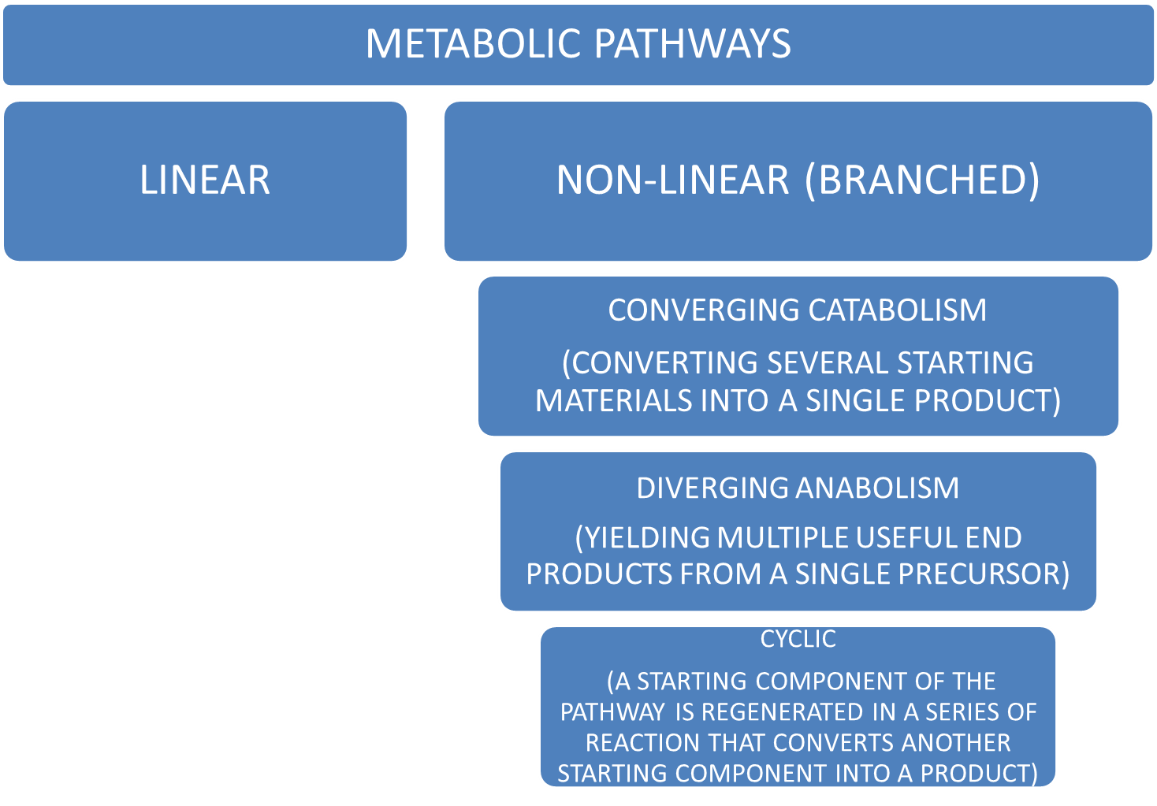

Slide 20
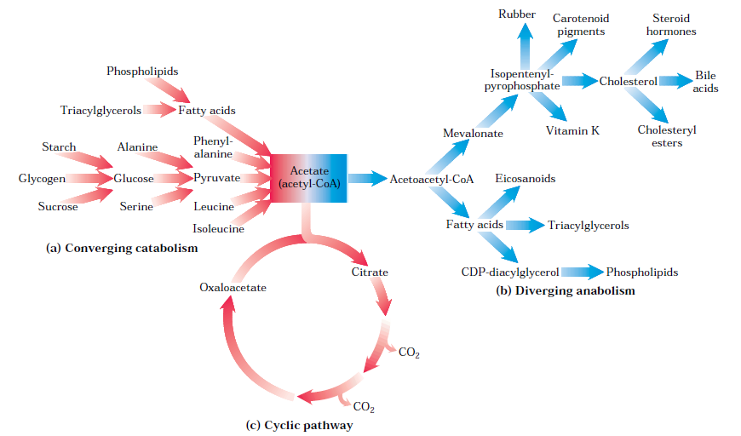

Slide 21
DIGESTION AND ABSORPTION OF CARBOHYDRATES

Slide 22
Definition of Digestion
Breakdown of food in the digestive system into small particles that can be easily absorbed into the body.
Digestive system is a 25 to 30 foot long tube. It includes the organs that secrete digestive juices.

Slide 23
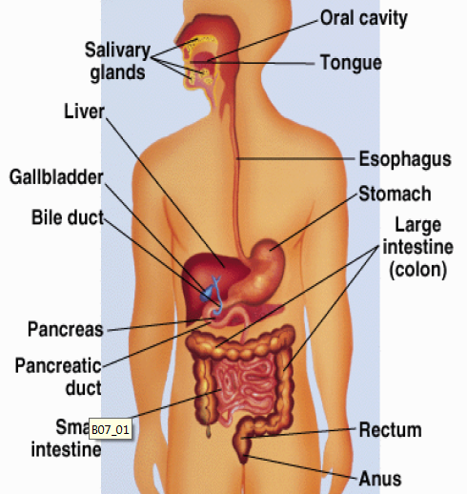

Slide 24
Digestion of Carbohydrate
Purpose of Digestion
To break down large carbohydrates into glucose units which are absorbable.
In one to four hours after eating, all the sugars and most of the starches are digested.

Slide 25
Mouth
Enzymes digest starch here salivary amylase hydrolyzes starch into shorter polysaccharide units.
Little digestion takes place here because the food is in the mouth for a short time.

Slide 26
Stomach
Starch digestion continues, salivary amylase is destroyed by acid so its action stops.
Although acid breaks down starch to some extent, no enzymes are present in the stomach to break down carbohydrates.

Slide 27
Stomach ejects the liquefied food into the small intestine (1-2 teaspoons) through the pyloric valve until all the food is in the small intestine.
These small ejection pulses stimulate intestinal walls to contract and relax, which in turn churn and mix the food with digestive enzymes.

Slide 28
Small intestine
- The small intestine carries out most of the digestion of carbohydrates.
- Major digestive enzyme is Pancreatic amylase.
The disaccharidases—maltase, sucrase-isomaltase (a bifunctional enzyme catalyzing hydrolysis of sucrose and isomaltose), lactase, and trehalase—are located on the brush border of the intestinal mucosal cells where the resultant monosaccharides and others arising from the diet are absorbed.
Pancreatic α-amylase yields mainly maltose and maltotriose (the di- and trisaccharides of α(1 4) glucose) and oligosaccharides called limit dextrins, fragments of amylopectin containing α(1 6) branch points.
  Fibers delay the absorption of carbohydrates and fats.

Slide 29
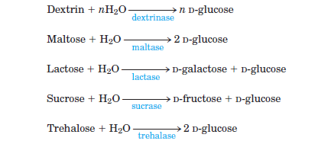
Disaccharides must be broken down into monosaccharides

Slide 30
Large intestine (colon)
Site of fiber action, includes softening stools and absorption of water.
Digestion of fibers by bacteria produce water, gas and fatty acids.
Any undigested carbohydrate may be broken down by intestinal bacteria.
Digestion is completed when macronutrients are reduced to an absorbable size and micronutrients are released from the food to be absorbed.

Slide 31
Absorption
Transfer of nutrients from the digestive system into the lymphatic and circulatory systems for distribution to the body cells.
Most absorption takes place in small intestine.
Water, sodium and end products of bacterial digestion are absorbed in the large intestine.

Slide 32
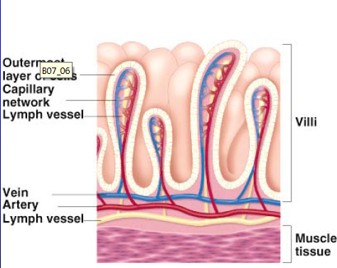
Villi
Lymph vessels and blood vessels are in the villi which line the intestinal tract. The lymph and blood vessels transport the absorbed nutrients to major branches of the lymphatic and circulatory systems.

Slide 33
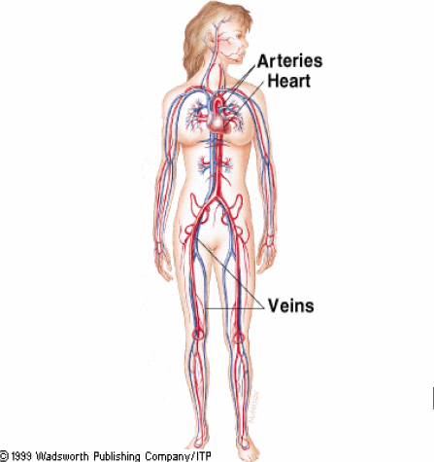
Glucose and amino acids are absorbed into the circulatory system

Slide 34
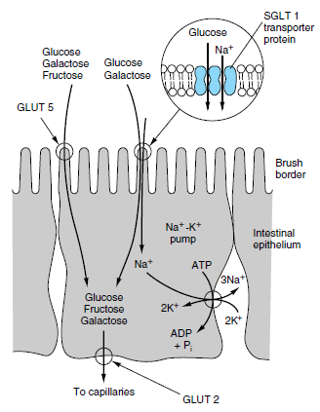
Intestinal Absorption of Glucose

Slide 35
Almost all absorption occurs at the intestinal villi.
The nutrients in the lymph and blood mix together in the heart and are then sent to the body cells through the circulatory system.

Slide 36
Carbohydrate are absorbed as simple sugars, Glucose is 99% absorbed.

Slide 37
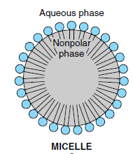
Digestion of fat
The major lipids in the diet are triacylglycerols and, to a lesser extent, phospholipids. These are hydrophobic molecules and must be hydrolyzed and emulsified to very small droplets (micelles) before they can be absorbed.
The fat-soluble vitamins—A, D, E, and K— and a variety of other lipids (including cholesterol) are absorbed dissolved in the lipid micelles. Absorption of the fat-soluble vitamins is impaired on a very low fat diet.

Slide 38
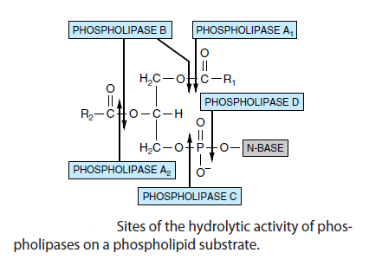
Hydrolysis of triacylglycerols is initiated by lingual and gastric lipases that attack the sn-3 ester bond, forming 1,2-diacylglycerols and free fatty acids, aiding emulsification.
Pancreatic lipase is secreted into the small intestine and requires a further pancreatic protein, colipase, for activity. It is specific for the primary ester links—ie, positions 1 and 3 in triacylglycerols—resulting in 2-monoacylglycerols and free fatty acids as the major end-products of luminal triacylglycerol digestion.

Slide 39
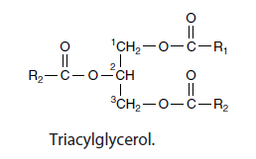
Monoacylglycerols are hydrolyzed with difficulty to glycerol and free fatty acids, so that less than 25% of ingested triacylglycerol is completely hydrolyzed to glycerol and fatty acids. Bile salts, formed in the liver and secreted in the bile, enable emulsification
All long-chain fatty acids absorbed are converted to triacylglycerol in the mucosal cells and, together with the other products of lipid digestion, secreted as chylomicrons into the lymphatics, entering the blood stream via the thoracic duct.

Slide 40
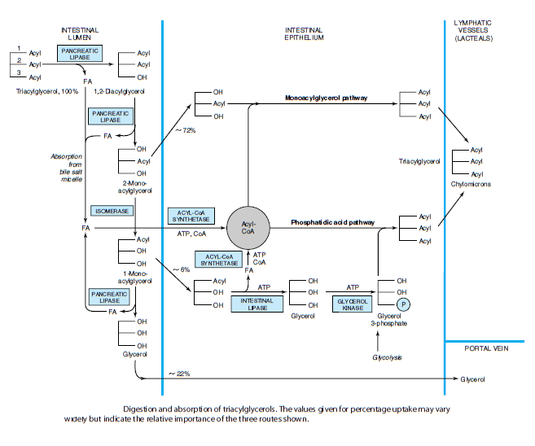

Slide 41
Digestion of protein
Several Groups of Enzymes Catalyze the Digestion of Proteins.
There are two main classes of proteolytic digestive enzymes (proteases), with different specificities for the amino acids forming the peptide bond to be hydrolyzed.
Endopeptidases hydrolyze peptide bonds between specific amino acids throughout the molecule. They are the first enzymes to act, yielding a larger number of smaller fragments, eg, pepsin in the gastric juice and trypsin, chymotrypsin, and elastase secreted into the small intestine by the pancreas.
Exopeptidases catalyze the hydrolysis of peptide bonds, one at a time, from the ends of polypeptides.

Slide 42
Carboxypeptidases, secreted in the pancreatic juice, release amino acids from the free carboxyl terminal, and aminopeptidases, secreted by the intestinal mucosal cells, release amino acids from the amino terminal.
Dipeptides, which are not substrates for exopeptidases, are hydrolyzed in the brush border of intestinal mucosal cells by dipeptidases. The proteases are secreted as inactive zymogens; the active site of the enzyme is masked by a small region of its peptide chain, which is removed by hydrolysis of a specific peptide bond.

Slide 43
Pepsinogen is activated to pepsin by gastric acid and by activated pepsin (autocatalysis).
In the small intestine, trypsinogen, the precursor of trypsin, is activated by enteropeptidase, which is secreted by the duodenal epithelial cells; trypsin can then activate chymotrypsinogen to chymotrypsin, proelastase to elastase, procarboxypeptidase to carboxypeptidase, and proaminopeptidase to aminopeptidase.

Slide 44
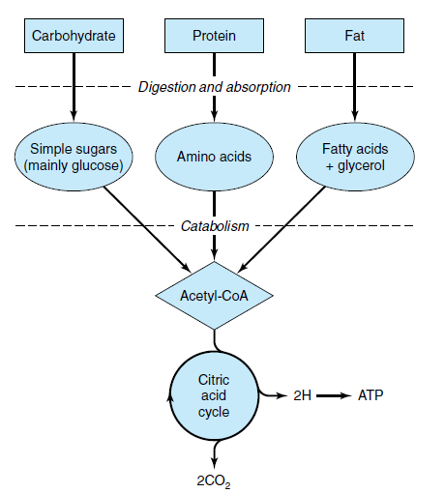
Overview of metabolism

Slide 45
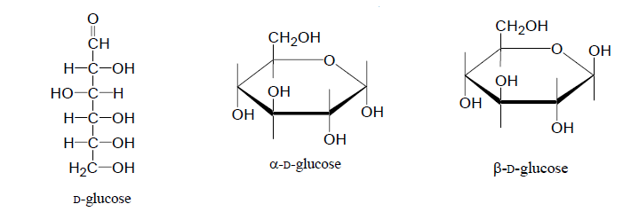
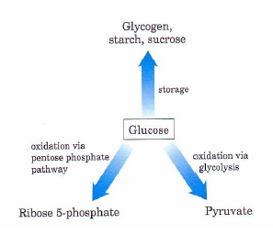
GLYCOLYSIS
D-Glucose is a major fuel for most organisms.
For higher plants and animals there are three major metabolic fates for glucose

Slide 46
Nearly every living cell catabolizes glucose and other simple sugars by a process called glycolysis.
Glycolysis differs from one species to another only in the details of regulation and the fate of pyruvate.
Glycolysis is the metabolic pathway that catabolizes glucose into two molecules of pyruvate.

Slide 47
Glycolysis occurs in the cytosol of cells and is essentially an anaerobic process since the pathway’s principle steps do not require oxygen.
Glycolysis consists of 10 enzyme catalyzed reactions.
The pathway can be broken down into 2 phases.

Slide 48
The net reaction produces 2 molecules of NADPH, 2 molecules of ATP, 2 molecules of Pyruvate per molecule of glucose.
2 Glucose + 2 ADP + 2 Pi + 2 NAD⁺
2 Pyruvate + 2ATP + 2 NADH + H⁺

Slide 49
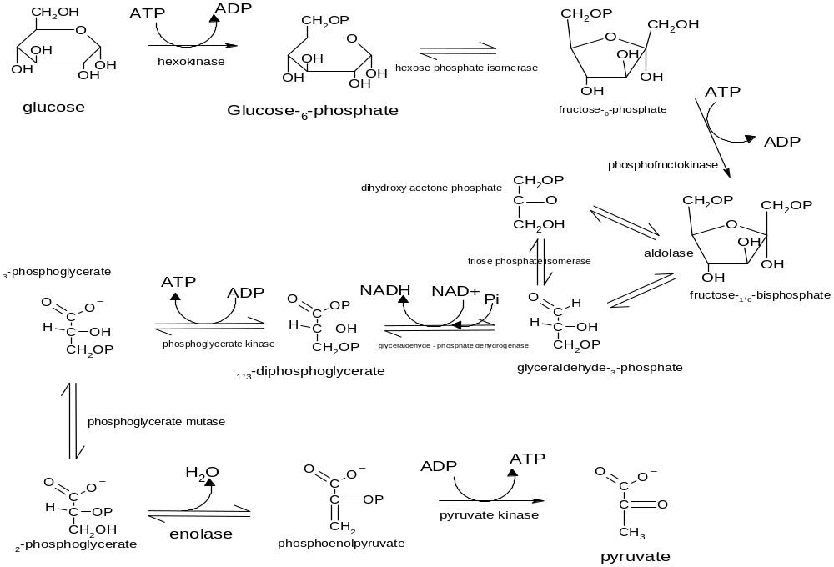
Schematic of Glycolysis

Slide 50
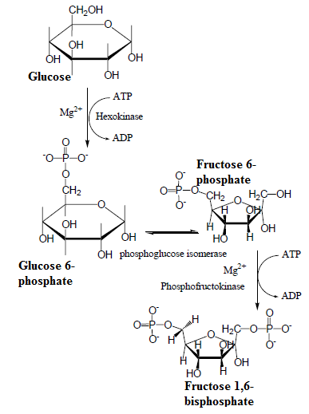

Phase 1: Preparatory phase

Slide 51
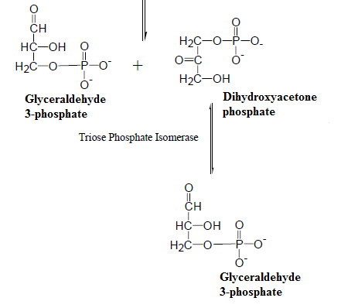

Slide 52
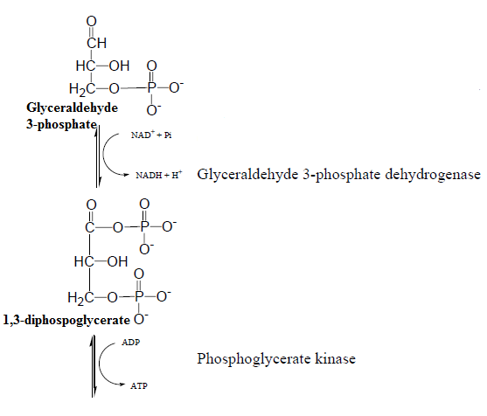
Phase II: Pay Off Phase

Slide 53
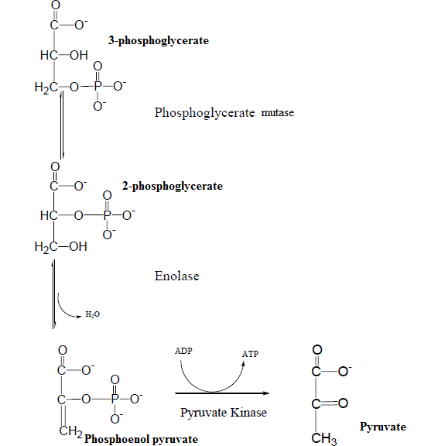

Slide 54

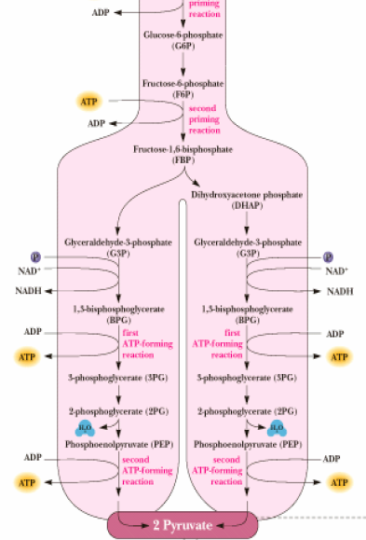
Bioenergetics of Glycolytic Pathway

Slide 55
Efficiency of the Glycolytic pathway
Glucose + NAD⁺ 2 Pyruvate + 2NADH + 2H⁺
ΔG₁^{i0} = -146 KJ/mol.
2ADP + 2Pi 2ATP
ΔG₂^{i0} = 2 (30.5 KJ/mol)= 61.0 KJ/mol
Overall ΔG⁰¹ = -146 + 61.0 = -85 KJ/ mol.
Or
Efficiency of Glycolysis = 61/2870
Where -2870 KJ/mol is the energy liberated as heat when 1 mol of Glucose is combusted.

Slide 56
Inhibitors of Glycolytic Pathway
Iodoacetate inhibits the Glyceraldehyde 3-phosphate dehydrogenase step.
Fluoride inhibits the Enolase step.

Slide 57
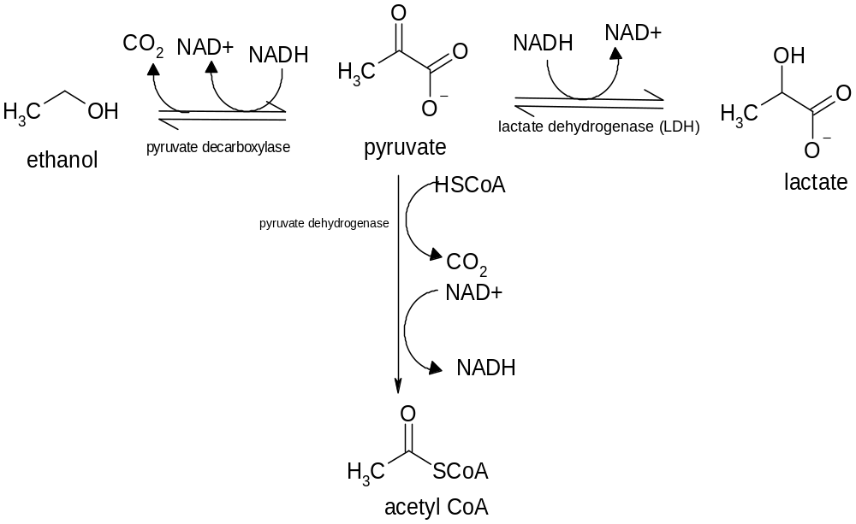
FATES OF PYRUVATE

Slide 58
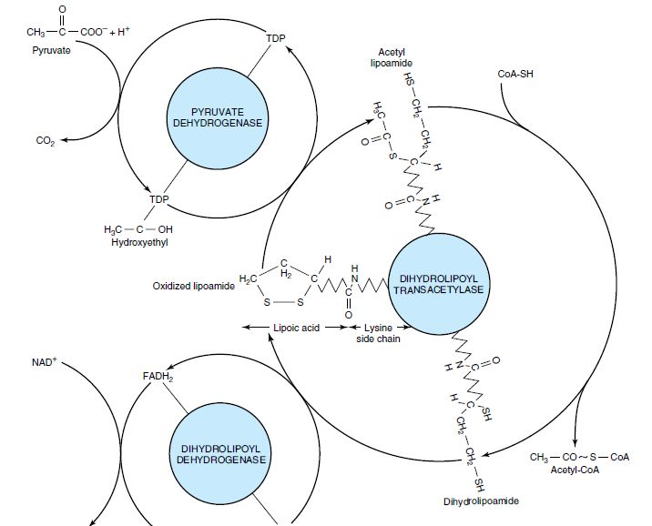

Oxidative Decarboxylation of Pyruvate to Acetyl CoA

Slide 59
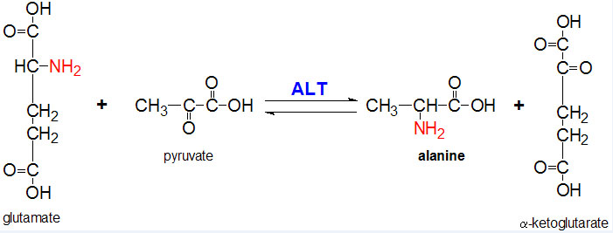
Conversion of Pyruvate to Alanine by an Aminotransferase (transaminase)

Slide 60
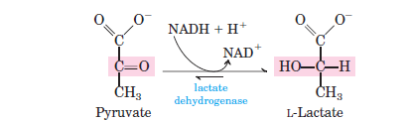
Conversion of Pyruvate to Lactate

Slide 61
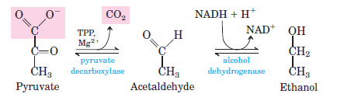
Conversion of pyruvate to Ethanol

Slide 62
LECTURE ENDS

Slide 63
Vitamins and their biochemical functions
Dr. Lawal R.A.
Dept of Biochemistry,
CMUL.

Slide 64
Ion | Examples of enzymes containing this ion
Cupric | Cytochrome oxidase
Ferrous or Ferric | Catalase Cytochrome Nitrogenase Hydrogenase
Magnesium | Glucose 6-phosphatase Hexokinase DNA polymerase
Manganese | Arginase
Molybdenum | Nitrate reductase Nitrogenase
Nickel | Urease
Zinc | Alcohol dehydrogenase Carbonic anhydrase DNA polymerase

Slide 65
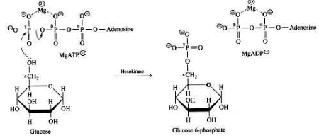
Hexokinase reaction

Slide 66
Cofactor | Vitamin | Additional component | Chemical group(s) transferred
Thiamine pyrophosphate | Thiamine (B₁) | None | 2-carbon groups, α cleavage
NAD⁺ and NADP⁺ | Niacin (B₃) | ADP | Electrons
Pyridoxal phosphate | Pyridoxine (B₆) | None | Amino and carboxyl groups
Methylcobalamin | Vitamin B₁₂ | Methyl group | acyl groups
Cobalamine | Cobalamine (B₁₂) | None | hydrogen, alkyl groups
Biotin | Biotin (H) | None | CO₂
Coenzyme A | Pantothenic acid (B₅) | ADP | Acetyl group and other acyl groups
Tetrahydrofolic acid | Folic acid (B₉) | Glutamate residues | Methyl, formyl, methylene and formimino groups
Menaquinone | Vitamin K | None | Carbonyl group and electrons
Ascorbic acid | Vitamin C | None | Electrons
Flavin mononucleotide | Riboflavin (B₂) | None | Electrons
Flavin adenine dinucleotide | Riboflavin (B₂) | ADP | Electrons

Slide 67
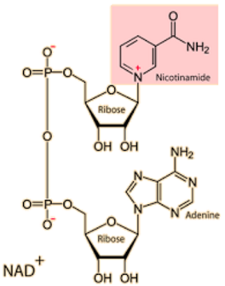
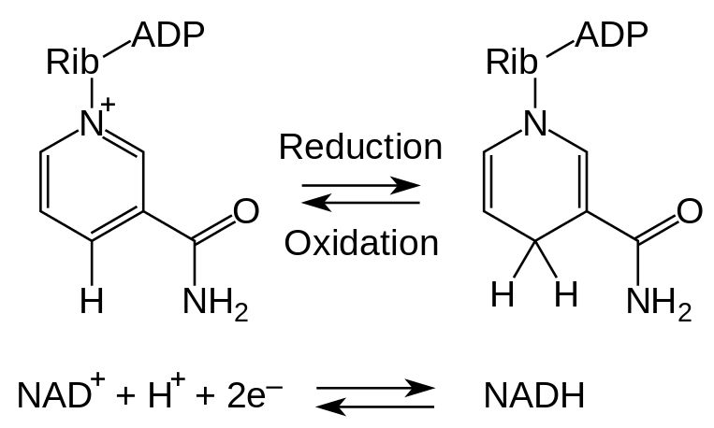
Oxidation-Reduction involving NAD⁺

Slide 68
N
Cofactor | Chemical group(s) transferred
Adenosine triphosphate | Phosphate group
S-Adenosyl methionine | Methyl group
Coenzyme Q | Electrons
Cytidine triphosphate | Diacylglycerols and lipid head groups
Glutathione | Electrons
Heme | Electrons
Lipoamide | Electrons, acyl groups
Molybdopterin | Oxygen atoms
Nucleotide sugars | Monosaccharides
Tetrahydrobiopterin | Oxygen atom and electrons

Slide 69
A coenzyme is a nonprotein organic molecule that binds to an enzyme to aid in the transfer of specific functional groups
Most coenzymes are derived from vitamins.
Vitamins are organic molecules that are needed in small amounts in the diets of some higher mammals.

Slide 70
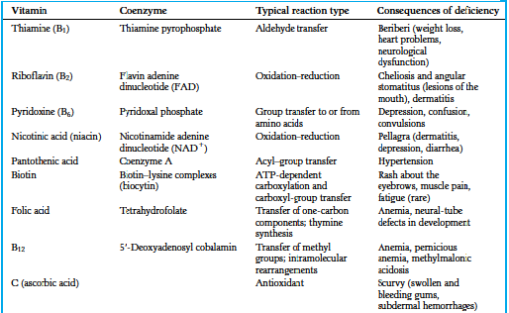
Water soluble vitamins

Slide 71
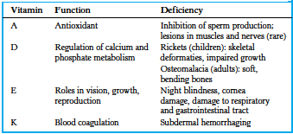
Fat soluble vitamins

Slide 72
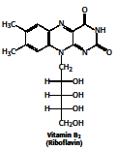


Slide 73



Slide 74



Slide 75
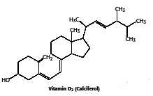
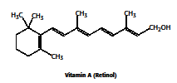

Slide 76
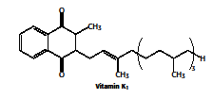
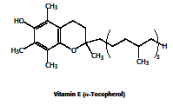

Slide 77
Physiological functions of hormones
Dr. Lawal R.A.
Dept of Biochemistry,
CMUL.

Slide 78
Hormones are substances formed by specialized organs or group of cells and carried (sometimes in the blood stream) to other organs or group of cells where they elicit their regulatory activity.
 | Group I | Group II
Solubility | Lipophylic | Hydrophilic
Receptors | Intracellular | Plasma membrane (Extracellular)
Transport Proteins | Yes | No
Plasma half-life | Hours to Days | Minutes
Mediator | Hormone-receptor element | Intracellular messengers (cAMP, cGMP, Phosphoinositides)
Types | Steroid hormones and calcitriol | Polypeptides, peptide, catecholamine
Examples | Androgens, Estrogens, Glucocorticoids, Mineralocorticoids, Progestins, Iodothyronines | Glucagon, Insulin, Vasopressin, Oxytocin, Epinephrine, LH, FSH, Prolactin.

Slide 79
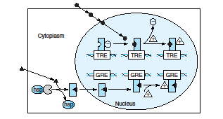
Mechanism of Action of Group 1 hormones

Slide 80
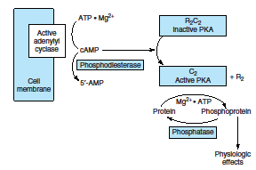
Mechanism of action Group 2 Hormones

